Slide 1
Multilingual BERT-Based Emotion Recognition: A Comparative Study in Urdu and Dari Texts
Group Number: 02
21241057 Malika Muradi
21141064 Basit Hussain
RA: Ehsanur Rahman Rhythm
ST: Mehnaz Ara Fazal

Slide 2
Introduction & Background
Introduction:
Emotion Recognitions help to understand public opinion
Help businesses to have data-driven decision
Background:
Low resource languages
Work done so far
Word Embeddings
Sentiment Analysis
Named Entity Recognition (NER)

Slide 3
Applications and Ideas:
Applications:
Advancing the language resources for Urdu and Dari
Analyzing the the emotions in both languages
Ideas:
Applying advanced application of NLP techniques, particularly BERT for emotion detection
Addressing and resolving the challenges and nuances presented by the Urdu and Dari languages

Slide 4
Challenges
Low resourced languages
Cultural and Regional variations
Limited data
Complex script

Slide 5
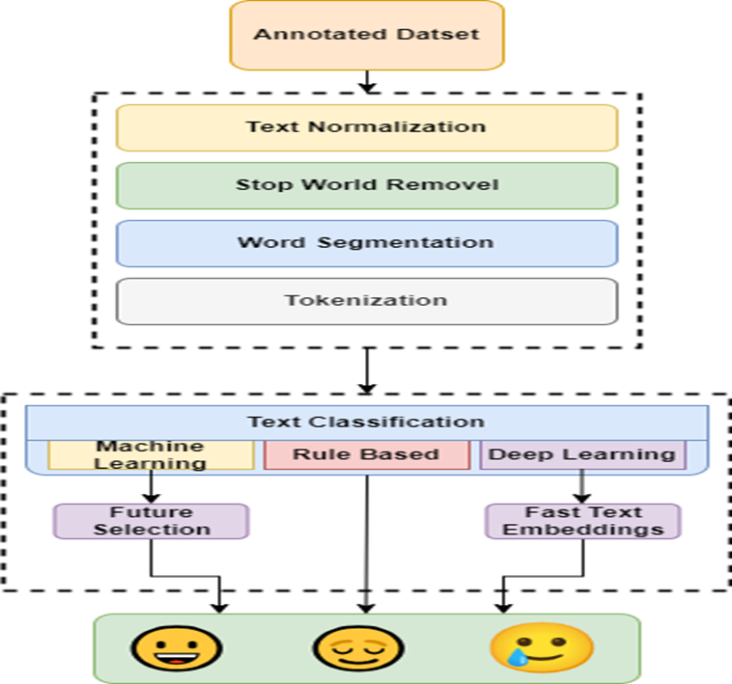
Methodology

Slide 6
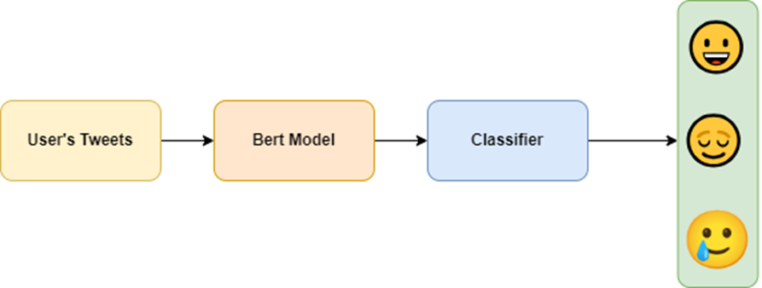
Methodology (Cont..)
BERT Model

Slide 7
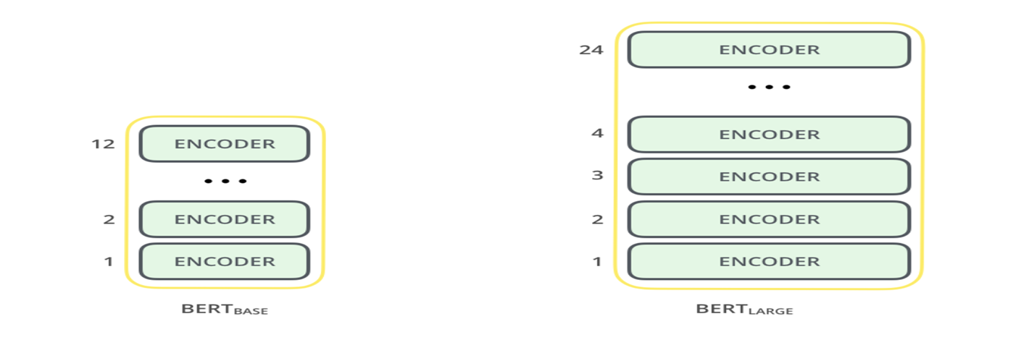
Methodology (Cont..)
● BERT’s Architecture

Slide 8
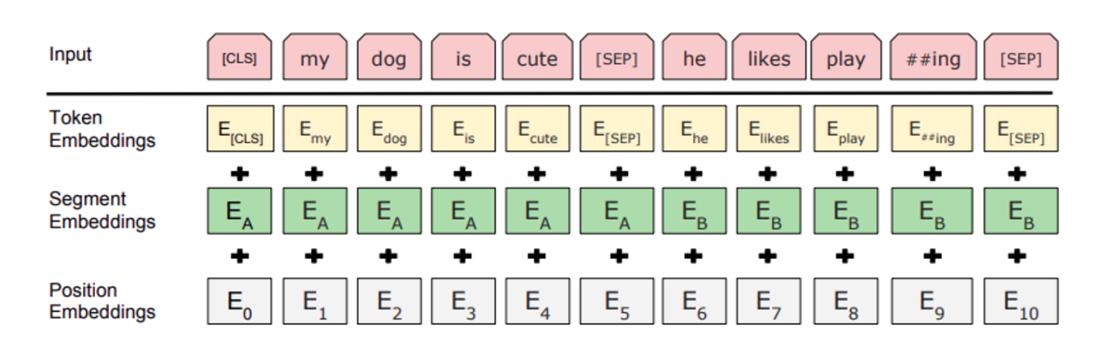
Methodology (Cont..)
●Text Preprocessing

Slide 9
Conclusion
●Multilingual emotion recognition using BERT in Urdu and Dari uncovers insights.
●Fine-tuned BERT.
●Contributing to cross-cultural emotional understanding.

Slide 10
THANK YOU

